Slide 1
Elixir, Java and What Wend Wrong with OOP
Georgi Yolovski

Slide 2
The concept of OOP
The term is coined by Alan Kay (a biologist) in the 1960s
Simulating the cells in living organisms
Cells have isolated internal states (data)
Decoupled from each other
Communicate through messages

Slide 3
Where are the classes?
“If I could do Java over again, I would leave out classes.” – James Gosling
“OOP to me means only messaging, local retention and protection and hiding of state-process, and extreme late-binding of all things.” – Alan Kay
It’s about encapsulation and message passing

Slide 4
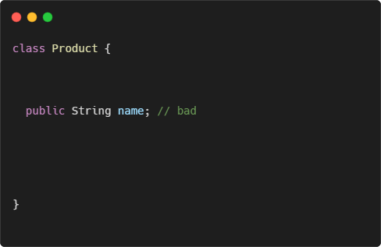
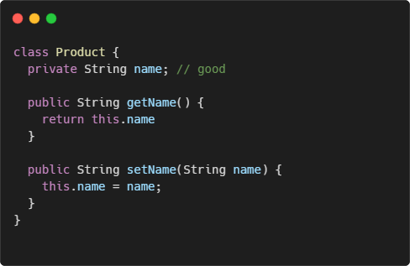
Let’s talk about encapsulation
What’s the difference?

Slide 5
What is encapsulation then?
It’s about avoiding shared mutable state
Reduce side effects
Less bugs
Forget about getters and setters

Slide 6
True OOP examples

Slide 7
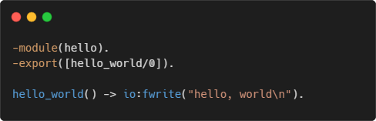
It all started with erlang
Developed in the 1980s by Ericsson
Runs on BEAM virtual machine
Suitable for telecoms
Distributed
Fault-tolerant
High-availability
Used by WhatsApp, RabbitMQ, Motorola

Slide 8
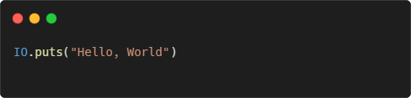
Enter elixir
Created in 2012 by Jose Valim
Runs on BEAM
Used by Discord, Pinterest, Spotify
Main features
Functional paradigm
Immutable data structures
Pattern matching
REPL and documentation as first-class citizen

Slide 9
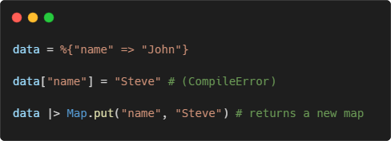
The real encapsulation
In Elixir everything is immutable
Records in Java/C# are a step in the right direction

Slide 10
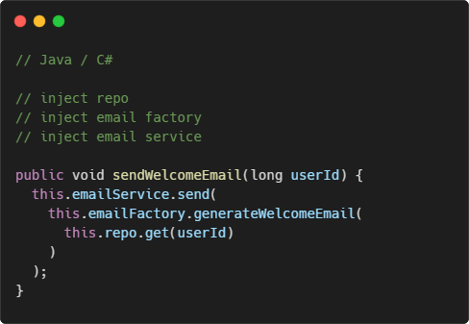
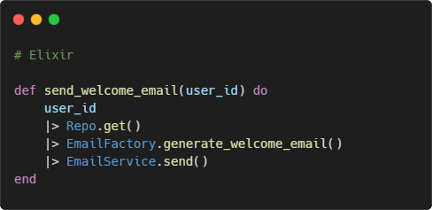
Functional programming
Focus on actions and business logic, not on objects and instances

Slide 11
Pattern matching
Popular in functional languages
Test whether the object matches a given expression
Cleaner control flow statements

Slide 12

Demo

Slide 13
REPL and doctests
Elixir has a built-in REPL (Read–eval–print loop)
Execute simple expressions
Start as part of the app
Attach to a running app
Doctests
Mix between unit tests and documentation
Keeps the documentation up to date

Slide 14
Demo

Slide 15
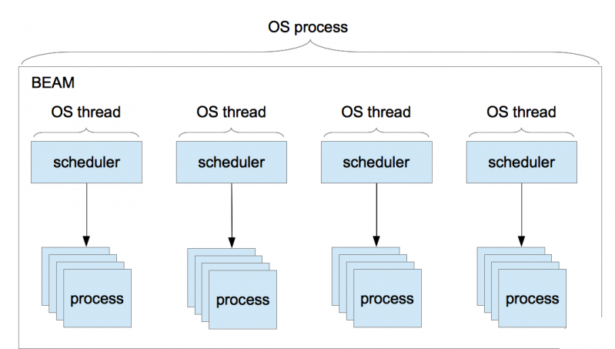
BEAM concurrency model
BEAM VM has its own scheduler
Runs lightweight processes
No shared state
Communication via message passing

Slide 16
Concurrency model benefits
Better performance (no locks)
Fault tolerance
Scalability – up to ~268M running processes

Slide 17
Demo

Slide 18
Why chose Elixir?
Code clarity
Less bugs
Development experience
Performance

Slide 19
Thank you

